Slide 1




NEXT GEN EMPLOYABILITY PROGRAM
Creating a future-ready workforce
Team Members
College Name
Student Name :K.DIVYA
Student ID :112021104004
Jaya Sakthi Engineering College

Slide 2

CAPSTONE PROJECT SHOWCASE
Project Title
MUSIC WEB APPLICATION USING DJANGO FRAMEWORK
Abstract | Problem Statement | Project Overview | Proposed Solution | Technology Used | Modelling & Results | Conclusion

Slide 3
Abstract Music Web Application Using Django Framework , is a dynamic and responsive musical web ,where the users can listen their favourite songs , trending songs etc. Also the users can upload a song and they can collect a watch later list too .if the users wants to download the song ,then the download option is enabled in the website. All these achieve through html, css , js, and using Bootstarp created more interactively with Django framework.
Source :

Slide 4
Problem Statement The aim of this project is to develop a user-friendly and interactive musical web application that allows music enthusiasts to explore, discover, and enjoy a wide range of music genres, artists, albums, and playlists. The application will provide a seamless and engaging experience for users to listen to music, create custom playlists, and connect with other music lovers in a vibrant online community
Source :

Slide 5
Project Overview The musical web application will feature a sleek and intuitive user interface that enables users to easily navigate through the platform. Users can search for their Trending songs, browse through curated playlists, discover new music recommendations, and create watchlater playlist as their preferences.
Source :

Slide 6
Proposed Solution To create a robust and engaging music web application, the following features and components are proposed: 1.User Registration and Profiles: Users can create accounts, customize profiles, and modify their profiles. 2.Music Library: A vast music library offering a wide range of songs, albums, and playlists across various genres.
Source :

Slide 7
4.Search and Watchlater:
Advanced search functionality to find specific songs, artists, albums, or genres.
Personalized creation of watch later list as per user preferences.
5. Offline Listening:
Option to download songs or playlists for offline listening.
6.Playlist Creation and Management:
Users can create custom playlists, organize songs, and share playlists with others.
Source :

Slide 8


Technology Used
Front-end
Back-end
Source :

Slide 9
Modelling & Results 1. Contains Interactive homepage and navigation bar 2. login page and sign up for new user creation 3. All songs navigation bar is enable to user where they can listen their favourite songs. 4. trending playlist contains the trending songs in cards display where the movie name, singers name etc are mentioned in description. 5. creation watchlater playlist for users as their preferences. 6. users can download the songs by clicking the download option button.
Source :

Slide 10
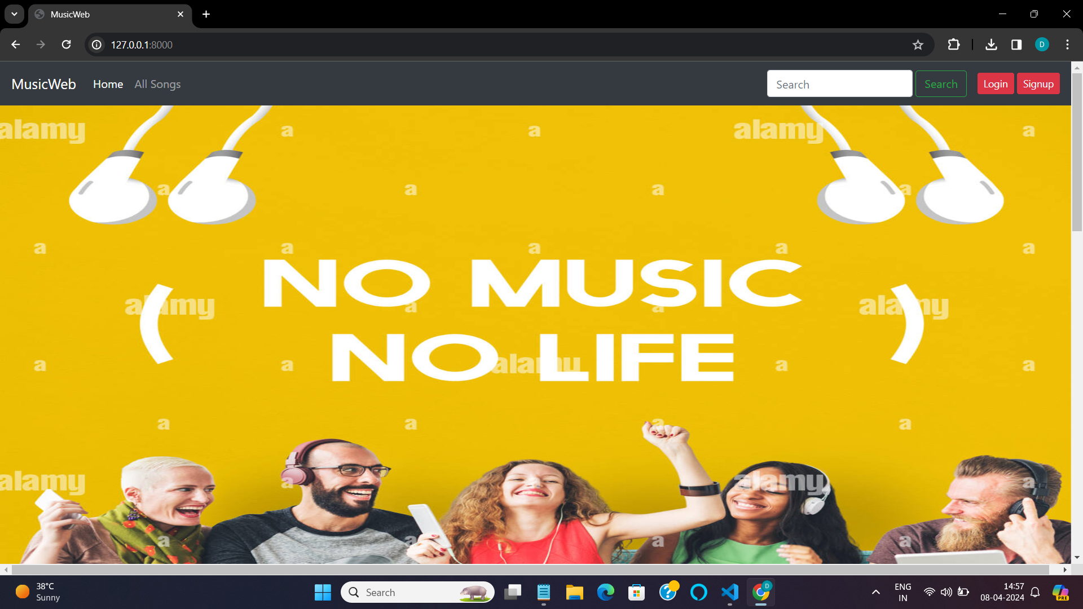
Homepage

Slide 11
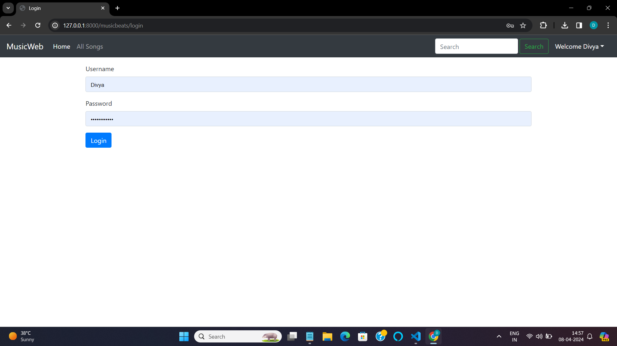

Slide 12
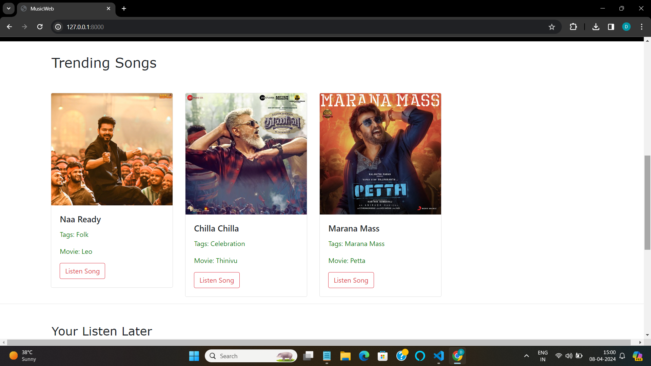

Slide 13
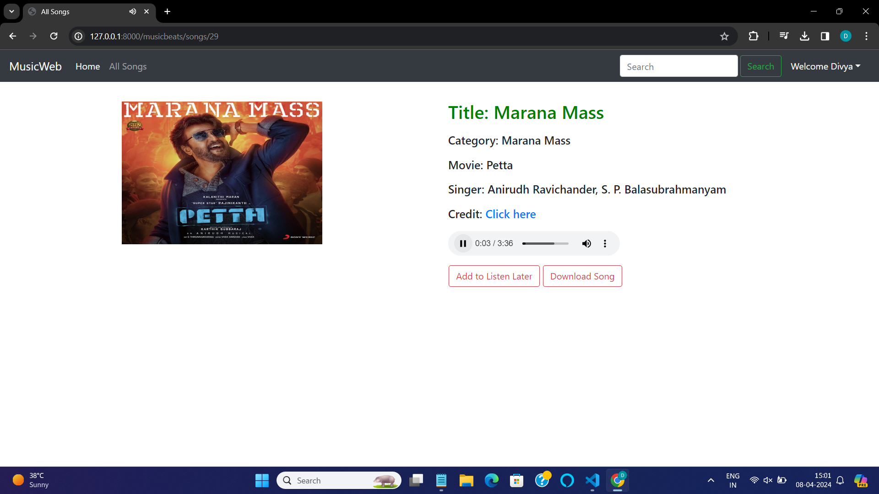

Slide 14
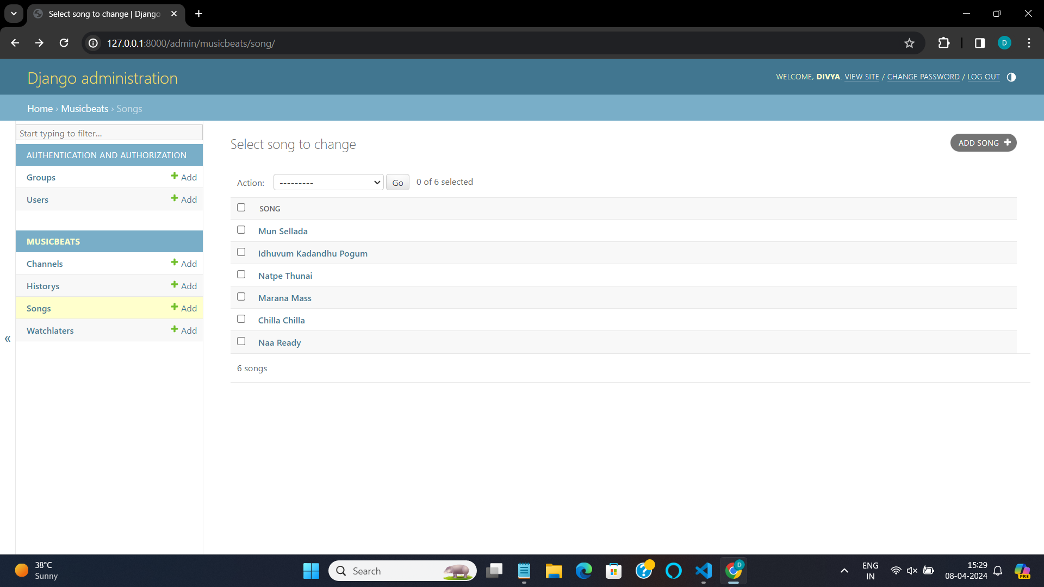

Slide 15
Future Enhancements: 1. Recommended playlist based on user preferences using AI 2. Subscription for users 3.Connect with socialmedia

Slide 16
Conclusion Music web application using Django is created with multiple speciality like listen, watchlater, download and upload a song. All the music lovers can listen to their favourite songs happily!
Source :

Slide 17
Thank You!
Notes:
Thank You !!

